Slide 1
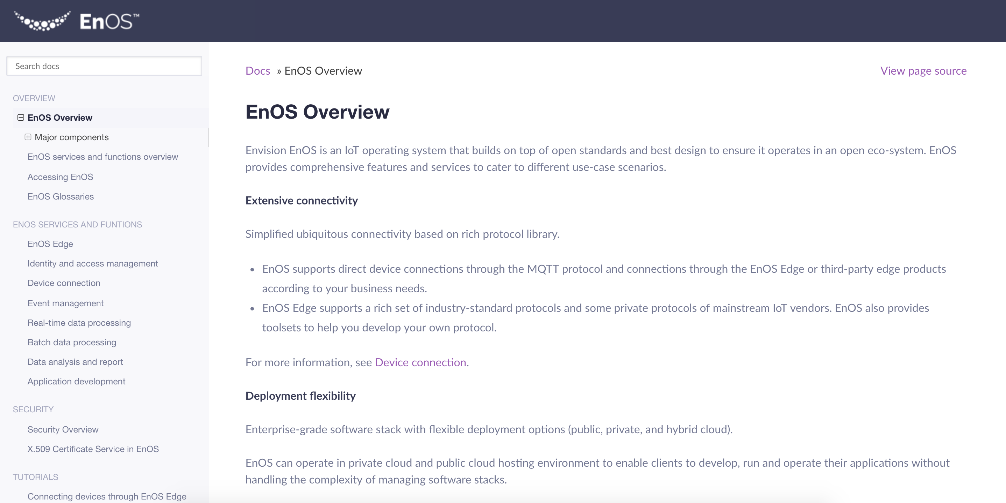
Screen capture
Pics of a display
Categories:
Screen capture
Annotated screen capture: callouts, thumbnail and zoom-in, numbered annotation
Animated screen capture
line：#F74C60 ， 2pt Solid Line
Title：#393C57 ，Helvetica or Arial 12pt Regular
Content：#393C57 ，Helvetica or Arial 12pt Light
If there is too much text, please wrap it according to the background frame. The spacing is 1x spacing by default.
Add Notes
Add Notes
Comment content 1
Comment content 2
Comment content 3

Slide 2
Create Project
Create Application
Create Deployment
Create a Pipeline
Configure Service and Route
Configure Config Map and Update the Deployment
Run the Pipeline and View the Results
Use the Published Application

